Slide 1
CS 584 Computer Networks-I Implementation of Link State Routing Simulation

Slide 2
Link State Routing Protocol
It is one of the two main routing protocol used in packet switched network and the other is one distance vector.
The basic concept of link-state routing is that every node constructs a map of the connectivity to the network, in the form of a graph, showing which nodes are connected to which other nodes. Each node then independently calculates the next best logical path from it to every possible destination in the network.
Dijkstra’s Algorithm is used to find the shortest path from each node to every other node

Slide 3
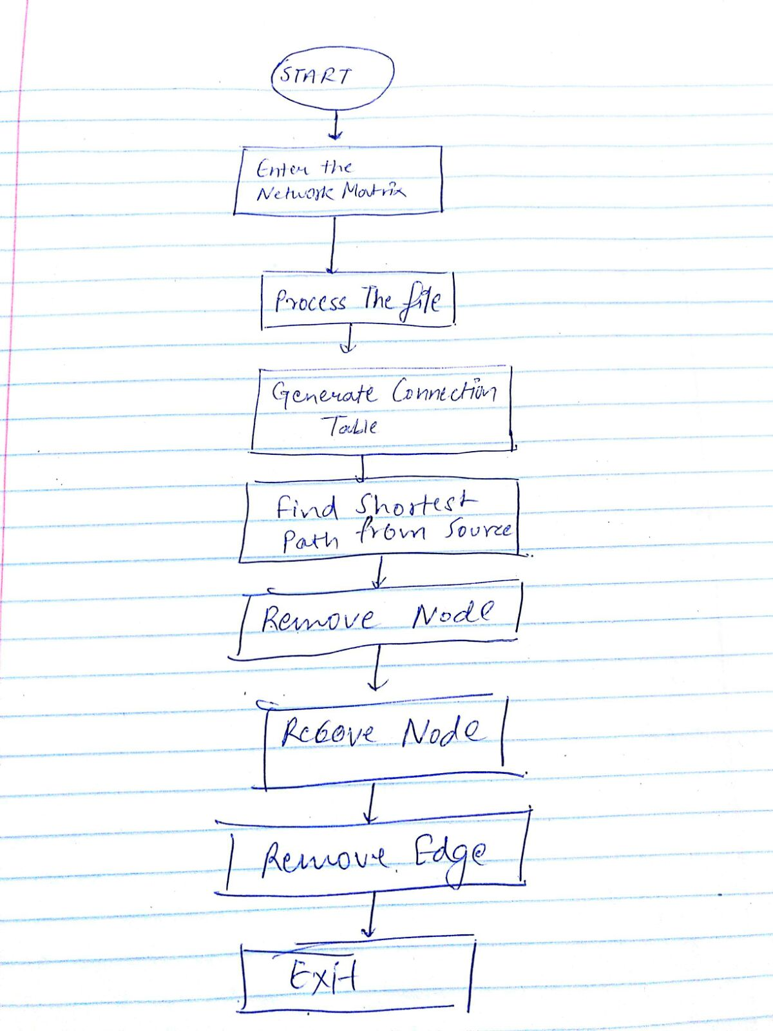
WORK FLOW

Slide 4
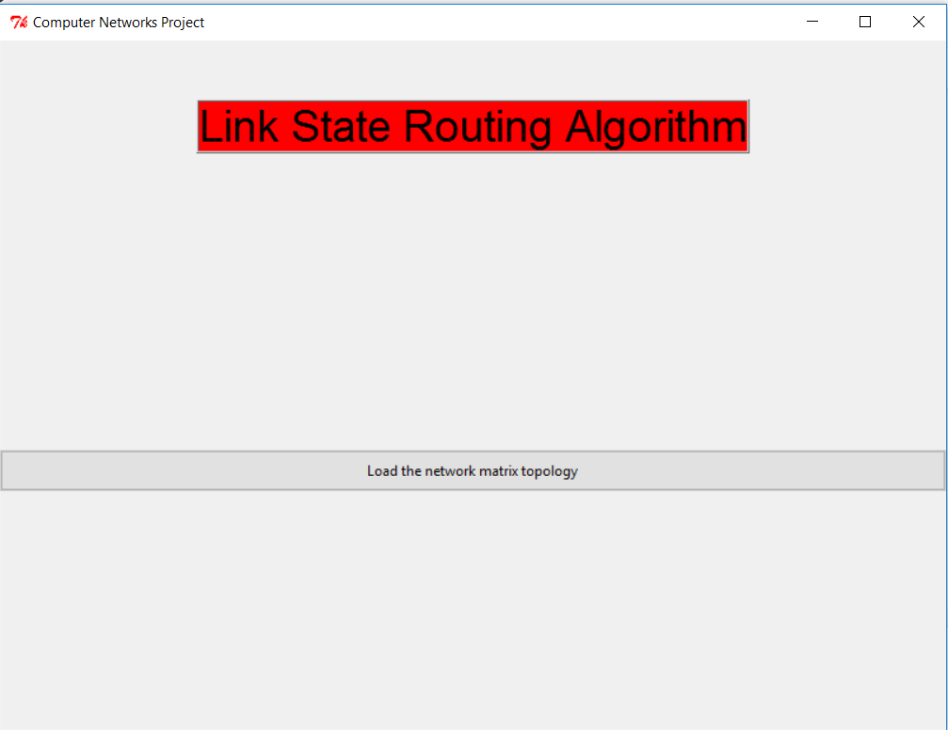
Welcome Screen

Slide 5
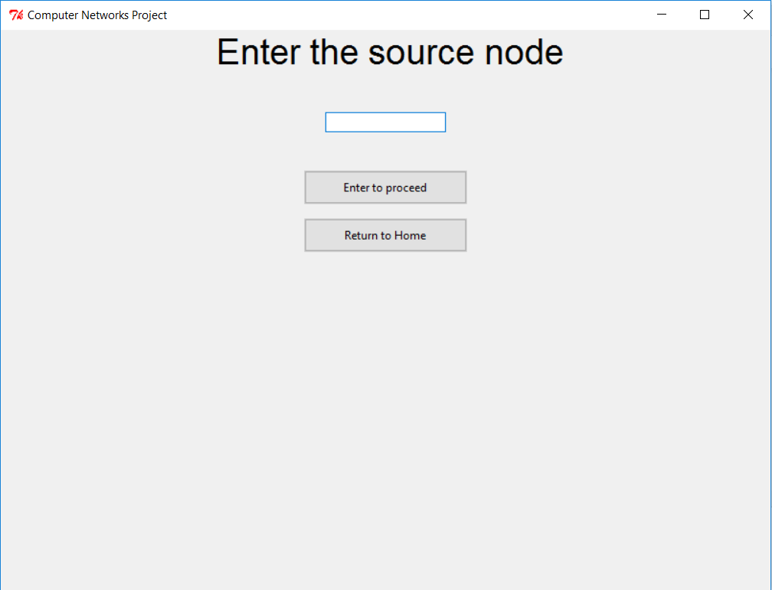
Enter the Source Screen

Slide 6
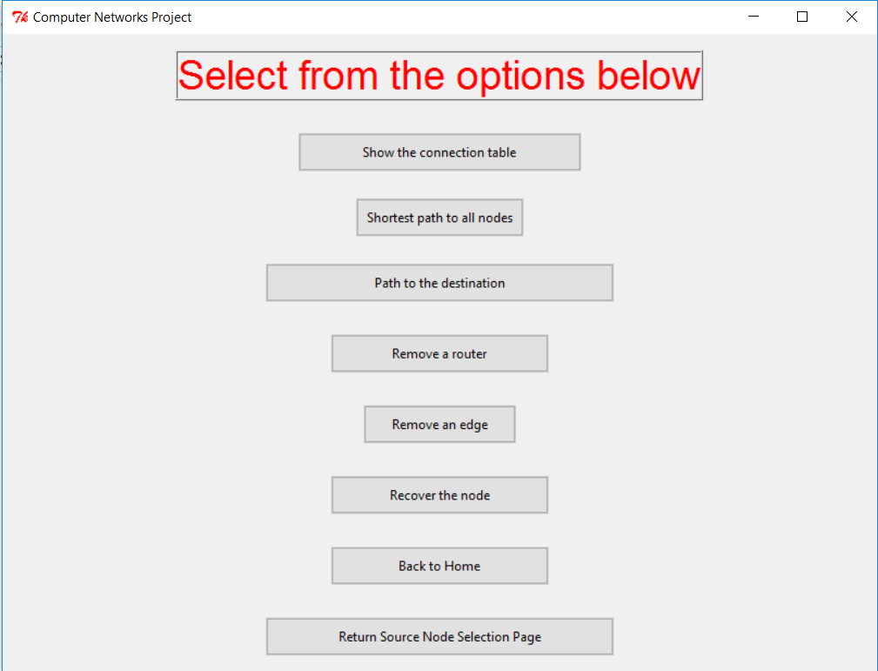
Home Screen

Slide 7
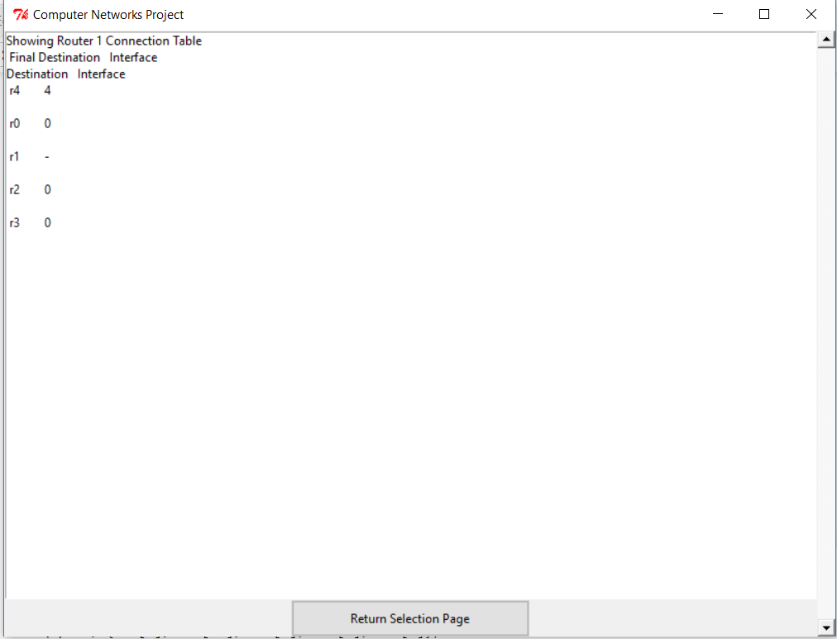
Connection Table Screen

Slide 8
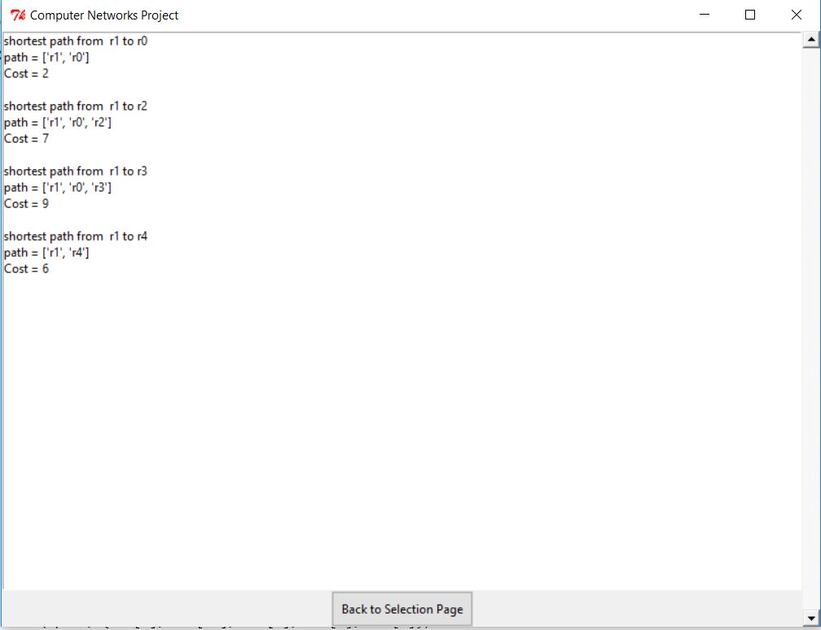
Shortest Paths to the nodes Screen

Slide 9
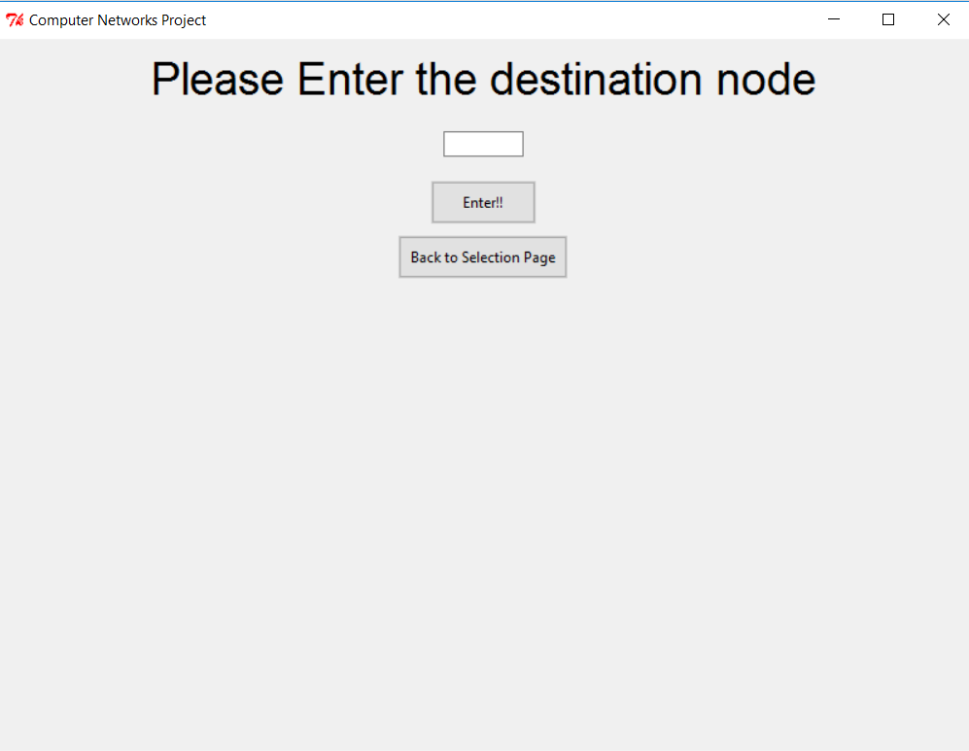
Destination Screen

Slide 10
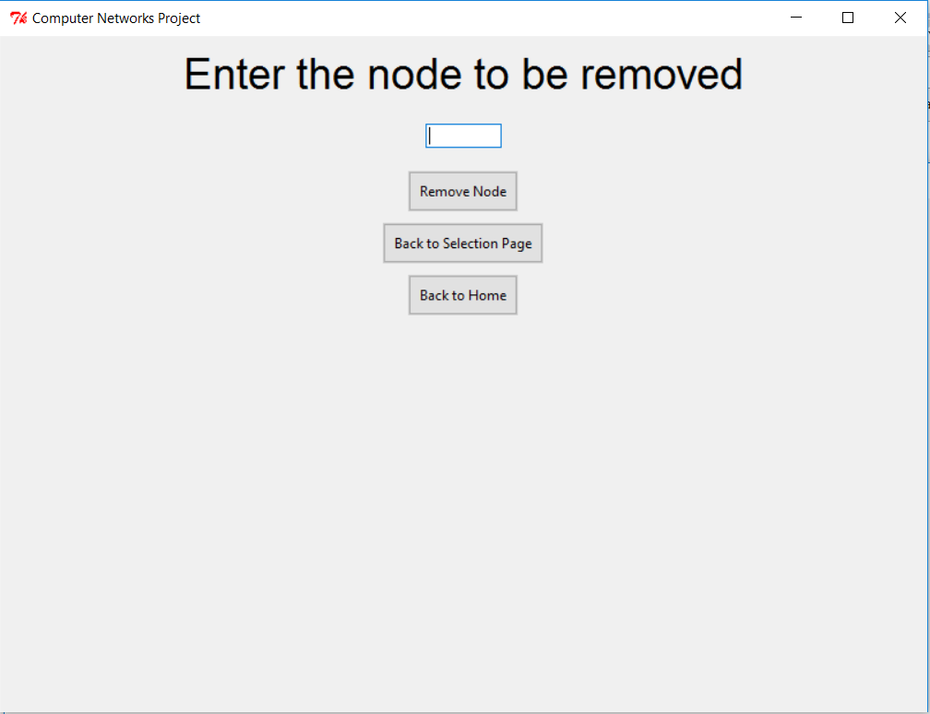
Remove Router Screen

Slide 11
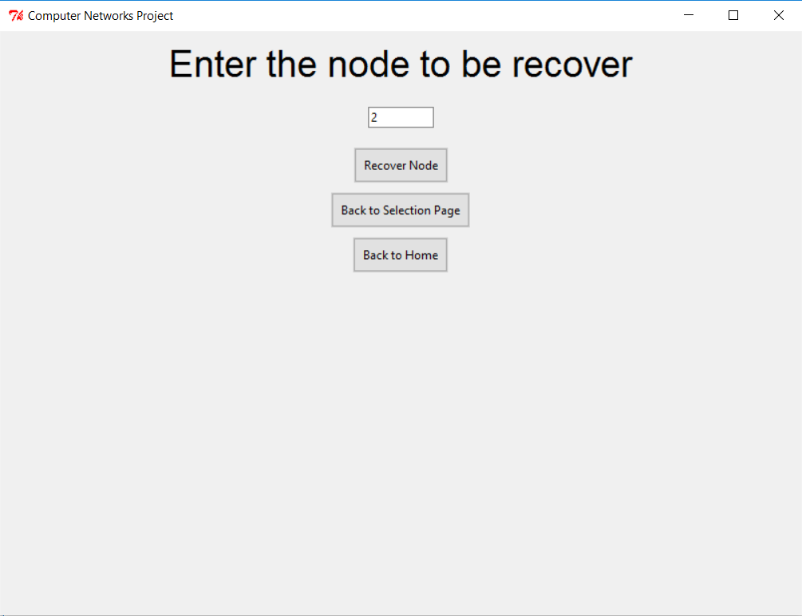
Recover Router Screen

Slide 12
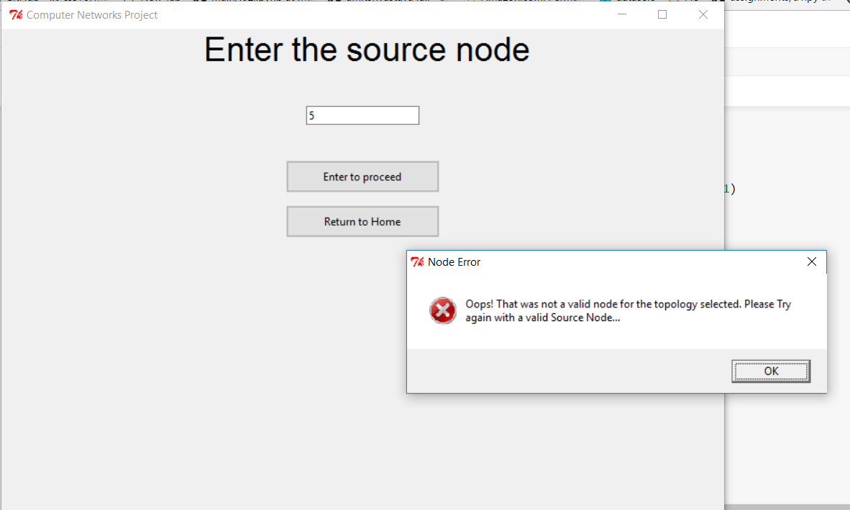
Validations

Slide 13
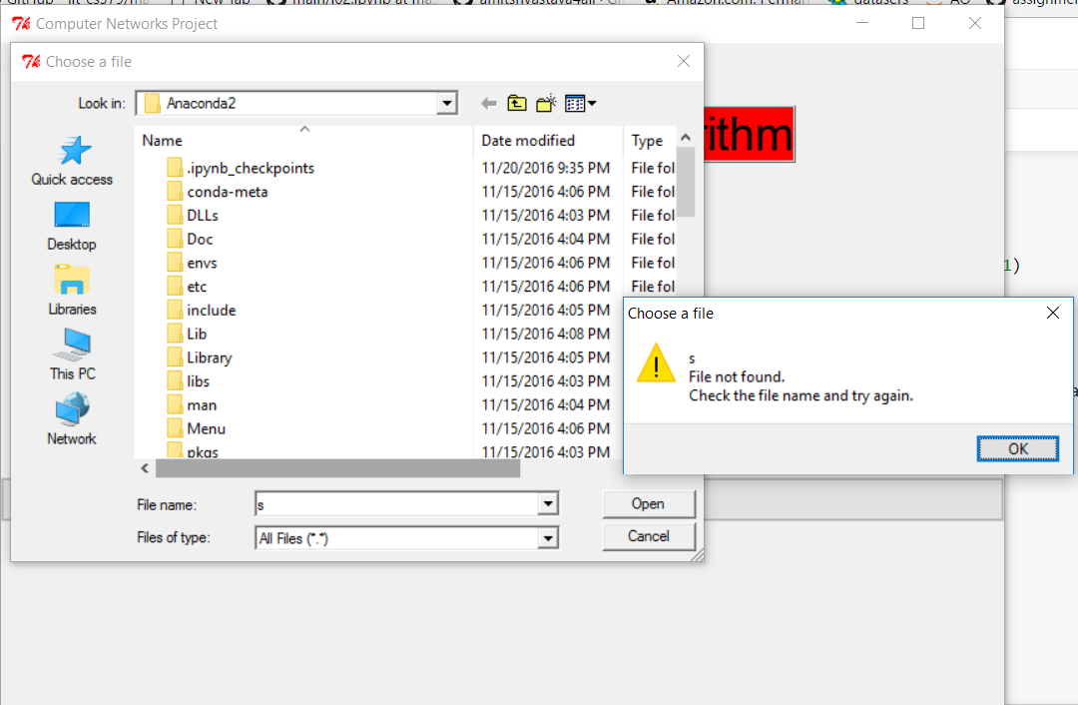
Validation

Slide 14
Features
GUI
Proper Documentation
Multiple Shortest path
If a router fails we can remove the router
We can also recover a router back including each and every edge with weights
If user wants they can remove a link between the router.
Generates the connection table giving the idea of the interfaces of the router

Slide 15
Conclusion
This project gives a simulation of Link State Routing algorithm and uses the Dijkstra's algorithm for shortest path.
The application can find and also display the shortest path from the sources to the destination entered by the user.

